Slide 1
Python project Object Recognisation and Detection

Slide 2
Object detection
Object detection refers to the detection and localization of objects in an image that belong to a predefined set of classes.
Tasks like detection and recognition find widespread applicability in real-world scenarios, making object detection a very important domain.

Slide 3
What is YOLO?
YOLO is an abbreviation for the term ‘You Only Look Once’.
This is an algorithm that detects and recognizes various
objects in a picture (in real-time).YOLO is an algorithm that
provides real-time object detection. This algorithm is popular
because of its speed and accuracy in detection of objects.

Slide 4
Requirements
Python
Open cv
TensorFlow
Absl (Abseil)
Darknet (for training purposes)
Yolov3 Algorithm

Slide 5
ROADMAP
Finalising the project. Finding resources to learn and study about the project
Building darknet and Traning custom weights for the project
Running the tensorflow model and successfully testing the code
1
3
5
2
4
6
Installing necessary libraries and packages needed for the project
Save the custom trained weight file as a tensor flow model
Various implementations of the projects (such as in security systems, for counting foofall of people etc.)

Slide 6
Overview of libraries used
OPENCV
OpenCV is a real-time Computer vision and image-processing framework built on C/C++. But we’ll use it on python via the OpenCV-python package.
TensorFlow
TensorFlow is an open-source library for machine learning and deep learning developed by the Google brains team. It can be used across a range of tasks but has a particular focus on deep neural networks.
ABSL
ABSL is a collection of Python library code for building Python applications.

Slide 7
Steps at a glance
First, import all the necessary packages required
Build and train custom weights through YOLOv4
Save the weights as a TensorFlow model
Running the tensor flow model
Run the code and check the accuracy as well as detection

Slide 8
Importing necessary packages
Here we import necessary packages required for our project into Python.
Next we write lines of code to implement them.
Packages include : OpenCV, TensorFlow, TQDM.
Build and train custom .weights file
Write command to clone and build Darknet in our G-collab Section.
Gather Custom Training and Validation Datasets from Google opensource Image Dataset.
Creating a zip file for both train and validation and Training sets, labeling them with unique annotations.
Conversion of dataset to train & text.txt files with their details using generate test and train.py programs.

Slide 9
Create custom.cfg according to classes trained alternating between filters and iterations and training classes.
Import convolutional layers which are very important in training the .weights file (explain).
Checking Custom Model accuracy with mAP.
Run code from PowerShell by deployment method (stable)
There are specific commands:-
python detect_video.py – video PATH for video detection in specific path or python detect.py –images PATH for image detection in specific path.
python detect_video.py –video 0 for video detection in REALTIME using webcam.
If you want to save your video output from Realtime, Use –output PATH/detection.avi where PATH is destination for file to be saved.

Slide 10
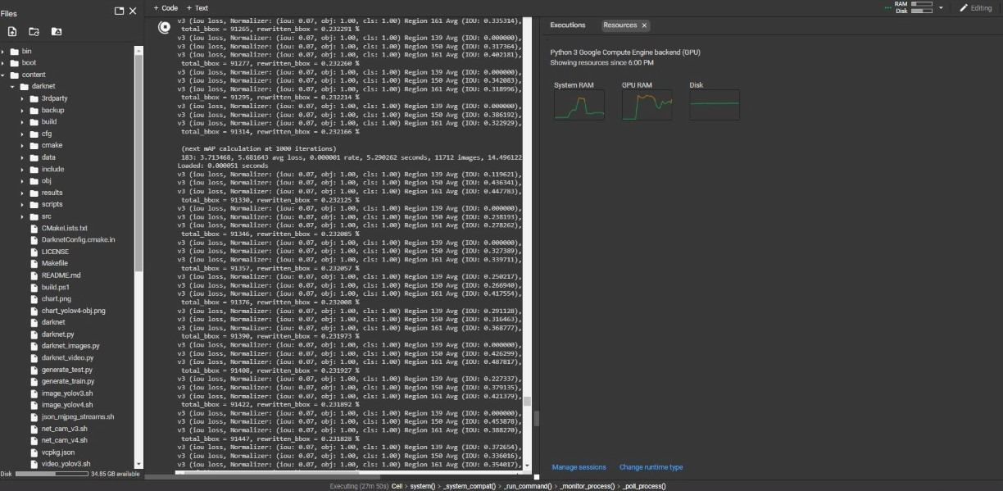
Few snippets of Operations…
No of iterations (current iteration 183) and training process ongoing.

Slide 11
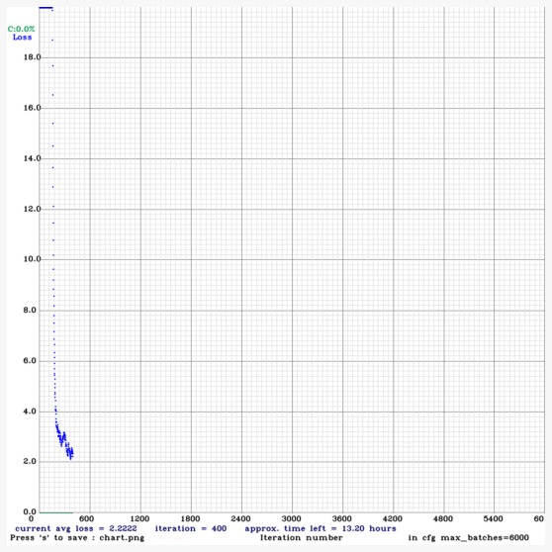
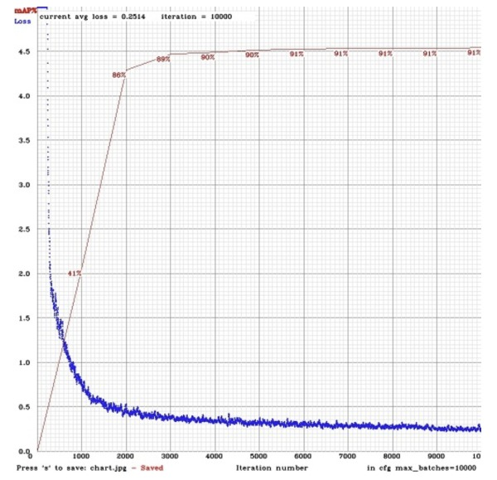
Tranning curves
mAP for our .weights file (13hrs training time)
Ideal mAP for .weights file.

Slide 12
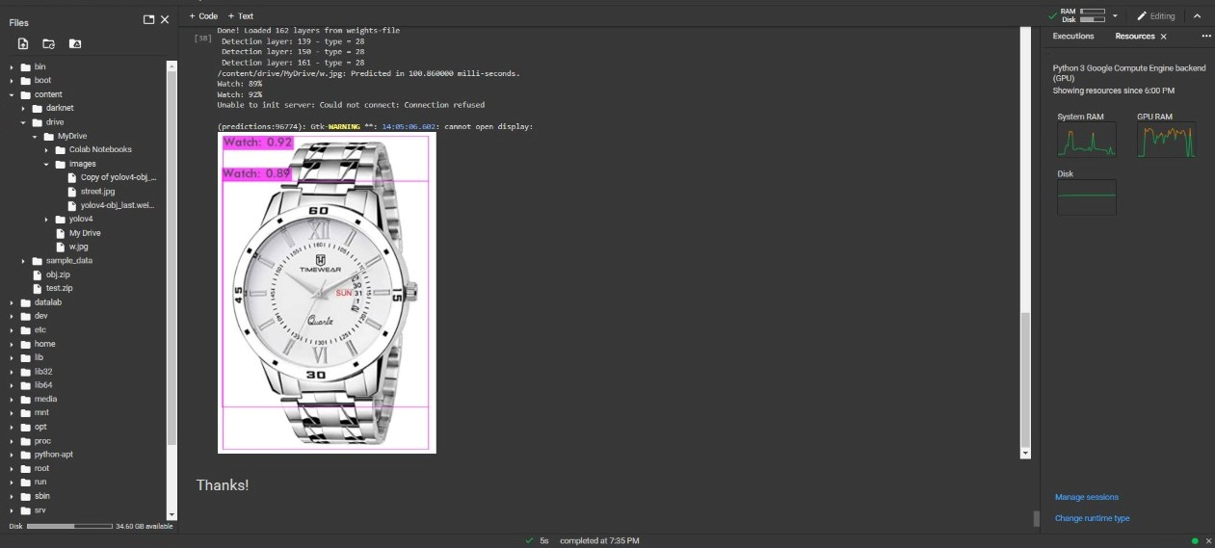
Drawbacks of training under >2 mAP for specific objects.
Resources required in span of
13 hours of continuous run orange color representing 80%+ usage.

Slide 13
Further Implementation of project for advanced objectives include..
Counting people
Object detection can be utilized for counting the footfall of people. It is utilized for group measurements during festivals or other mass gathering for efficiently keeping a track on number of people by detecting their head structure and processing it.
Vehicle detection (Current Objective)
By using Vehicle Detection technique we can detect the number plate of a speeding car specific objects entering or exiting a particular area. This can also potentially help security services to reduce the number of traffic law violations and keep track of the vehicles efficiently as well as take preventive measures for the same.
Security
Face recognition has immense potential in security domain, It is already been extensively used for security purposes in world. The 2019 Brit Awards used facial recognition technology to enhance its event security, deploying it to screen guests at multiple entrances to the in London.

Slide 14
THANK YOU
Project by:
Arya S. Purohit (19) & Eshan S. Dhok (41)
Electrical Engineering (6th semester)

